Slide 1
Top Tips
This poster template is not mandatory but you are highly encouraged to use it! You are welcome to adapt it to meet your needs.
To make posters more accessible, recent research recommends:
  Big figures and text
  Less clutter
  Plain language
  Clear reading order
  Consider an online audio walkthrough accessible via a QR code and a few handouts for people who can’t scan a QR code
In your main findings and elsewhere, use bold to emphasize the important words.
The colour behind the main findings box can be changed –to a solid colour, a texture, or even a picture.
You are welcome to change the colours to match your Cochrane Group or host institution. You can find the Cochrane HEX colour codes in the last slide.
To create a QR code, we recommend the free QR code maker at QR Code Monkey.
Want to link your QR code to your paper and a copy of your poster and your contact details? Try hosting the links all in one spot and link to that; it could be a social media post that you link to or a free online tool like Linktree.
If you’d like to use a picture on your poster, we recommend that you choose light and bright imagery that works in harmony with your group’s colour palette. Select positive, simple, and close-up images. See our image check-list for more help.

Slide 2

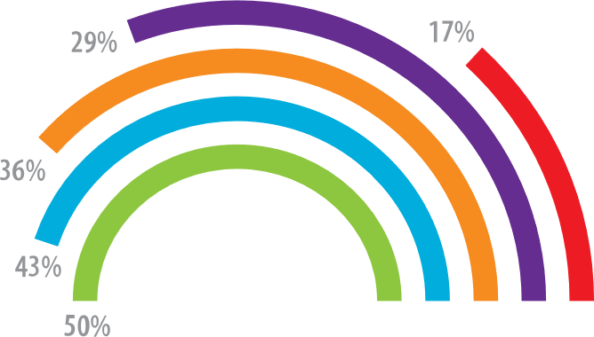
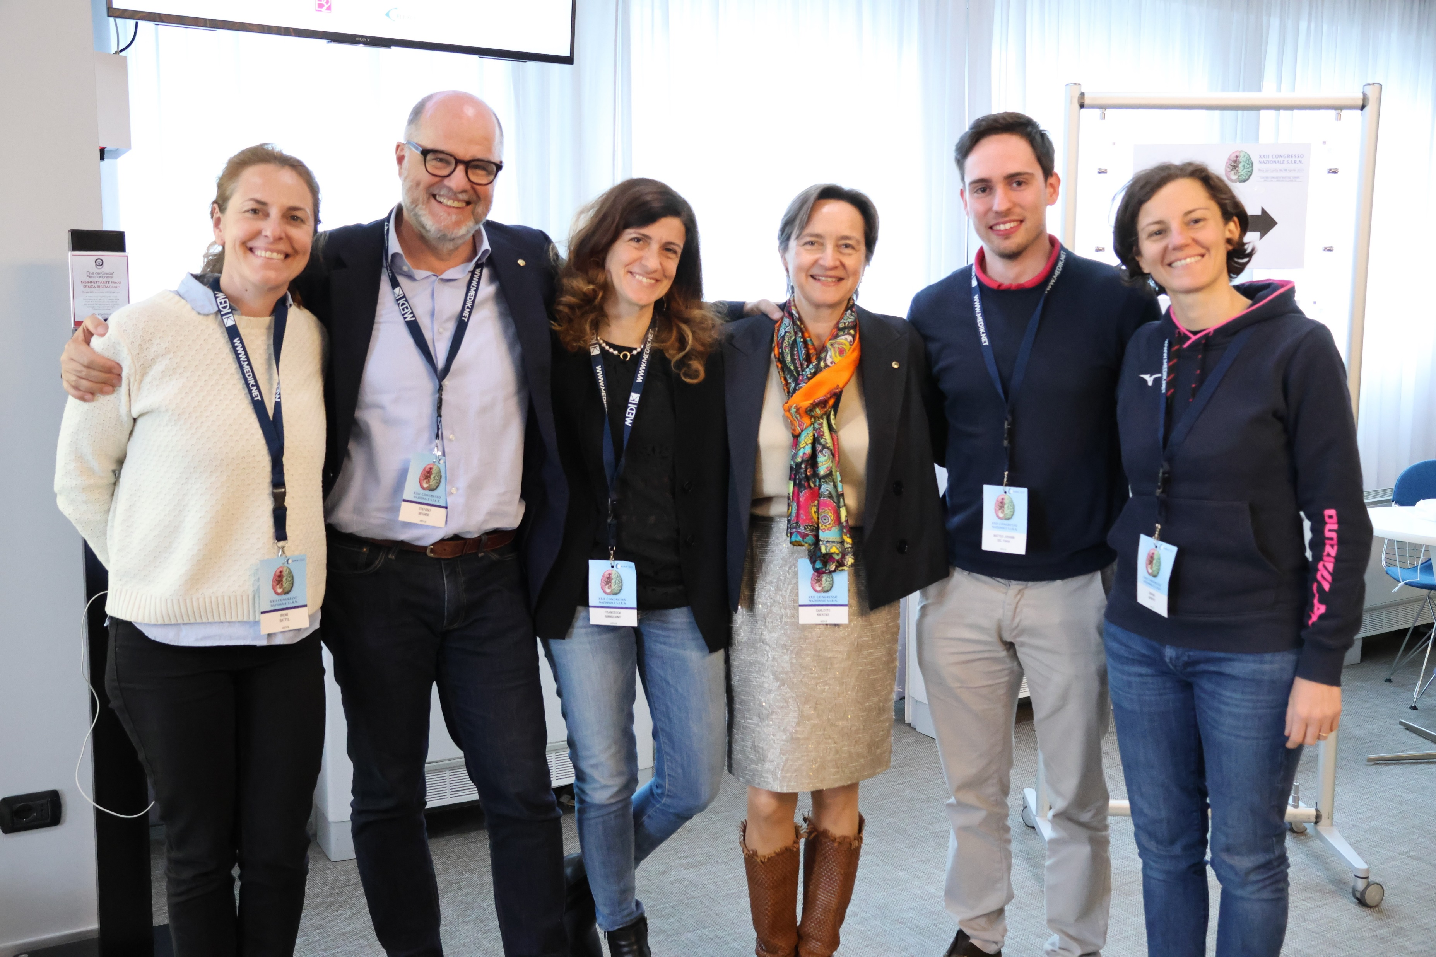
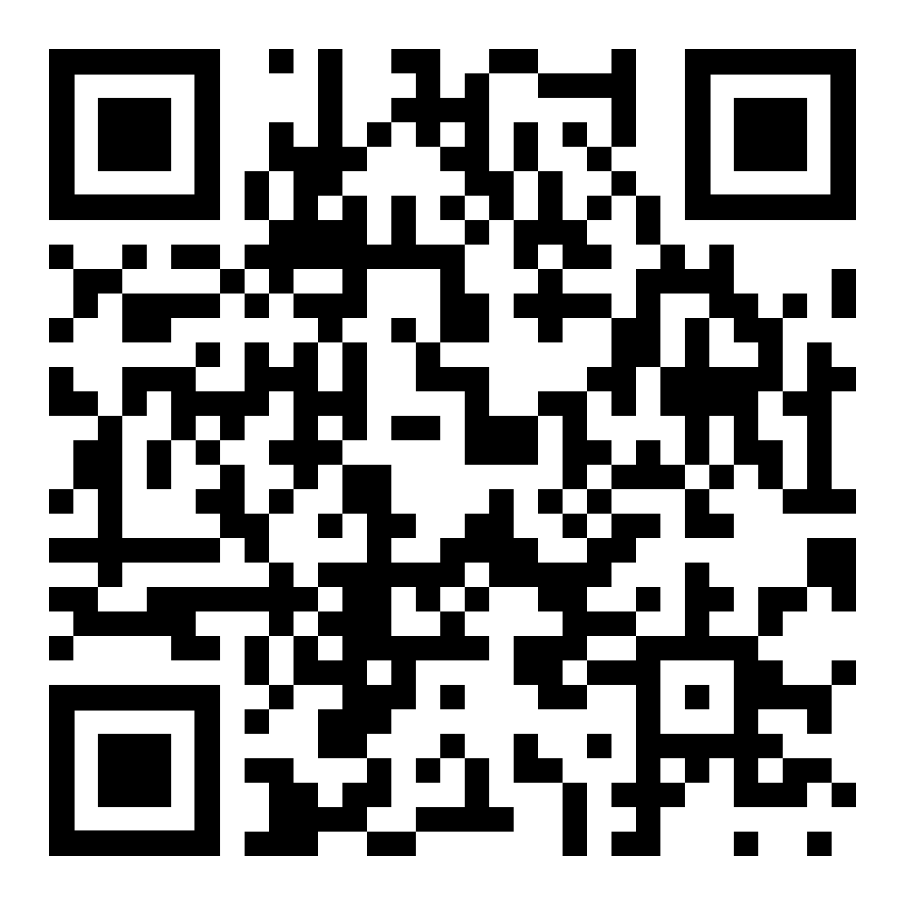

Teach people what you
learned in 5 seconds
Title goes here: Investigating the dynamics of X on Y.
Background: 70,000 people needed a portrait-orientation style layout for #betterposter, according to the Open Science Framework download counts.
Result 1: Quickly explain what the graph shows. Help people think.
Result 2: You can add bullets or quotes to this section too.
v
v
“Here is a quote that illustrates a main finding. You can use bold to highlight main points if you like”
- Survey Respondent
Methods
Survey
Longitudinal
v
You can list out the main steps and points here
You can list out the main steps and points here
You can list out the main steps and points here
You can list out the main steps and points here
You can list out the main steps and points here
You can list out the main steps and points here
You can list out the main steps and points here
You can list out the main steps and points here
You can add graphics, pictures, or more text
.
Limitation: This is only one interpretation of findings that suggest effective posters are uncluttered, have big figures & text, and include callout boxes with takeaways. It is missing your personality and creative flair.
Cochrane Group Name
Leeroy Jenkins, Shuri Wright, Emmett Brown
If a published paper, you can include the citation here.

Slide 3
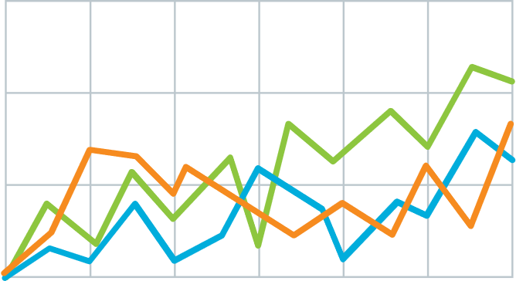
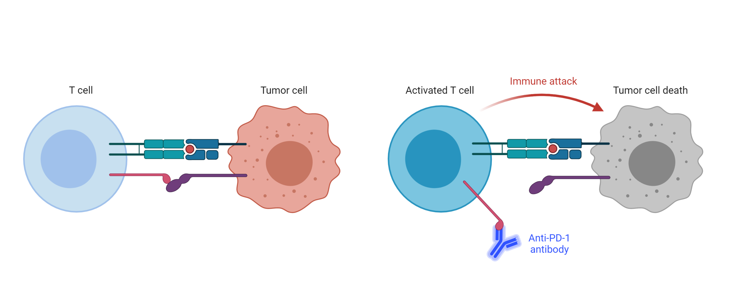

Teach people what you learned in 5 seconds (takeaway, not title)
Title goes here: Investigating the dynamics of X on Y.
Background: 70,000 people needed a portrait-orientation style layout for #betterposter, according to the Open Science Framework download counts.
Result 1: Quickly explain what the graph shows. Help people think.
Result 2: Big figures are easier to skim at a distance, and more accessible.
v
v
Methods
Survey
Longitudinal
v
1
Immune checkpoint inhibits T-cell activation.
2
Anti-PDF-1 antibodies permit T cell activation
Limitation: This is only one interpretation of findings that suggest effective posters are uncluttered, have big figures & text, and include callout boxes with takeaways. It is missing your personality and creative flair.
Leeroy Jenkins, Shuri Wright, Emmett Brown

Slide 4
For Cochrane Groups
If you are part of a Cochrane Group, you are welcome to change the colours of the poster to match the group. Here are the HEX codes:
Blue:
CMYK 100.72.0.38
HEX 002D64
Purple:
CMYK 42.91.0.0
HEX 962D91
Cyan:
CMYK 100.52.0.0
HEX #0057B7
Red:
CMYK 0.95.100.0
HEXE12328
Teal:
CMYK 100.4.56.8
HEX #008578
Orange:
CMYK 2.77.100.9
HEX #B94700
Green:
CMYK 89.0.96.30
HEX #007A3E
Magenta:
CMYK 0.100.2.0
HEX #D00070
You can also add the Cochrane Group name at the bottom and the logo. If you do not have the logo file, please speak to your Group or email support@cochrane.org
Other resources:
Full Brand Guidelines

Slide 5
Printing
Posters should be printed on A0 size
84.1cm (width) x 118.9cm (height)
33.11 inches (width) x 46.81 inches (height)

